Slide 1


Green Pace
Security Policy Presentation
Developer: Shakira Medlock
Southern New Hampshire University

Slide 2

OVERVIEW: DEFENSE IN DEPTH
This presentation presents policies, standards, principles, and best practices that help prevent the threat of potential security vulnerabilities in both code development and systems architecture.
Notes:
Introduce your security policy. Summarize why it was needed and how it will be used to support the defense-in-depth best practice. (The slide already contains the illustration.)

Slide 3
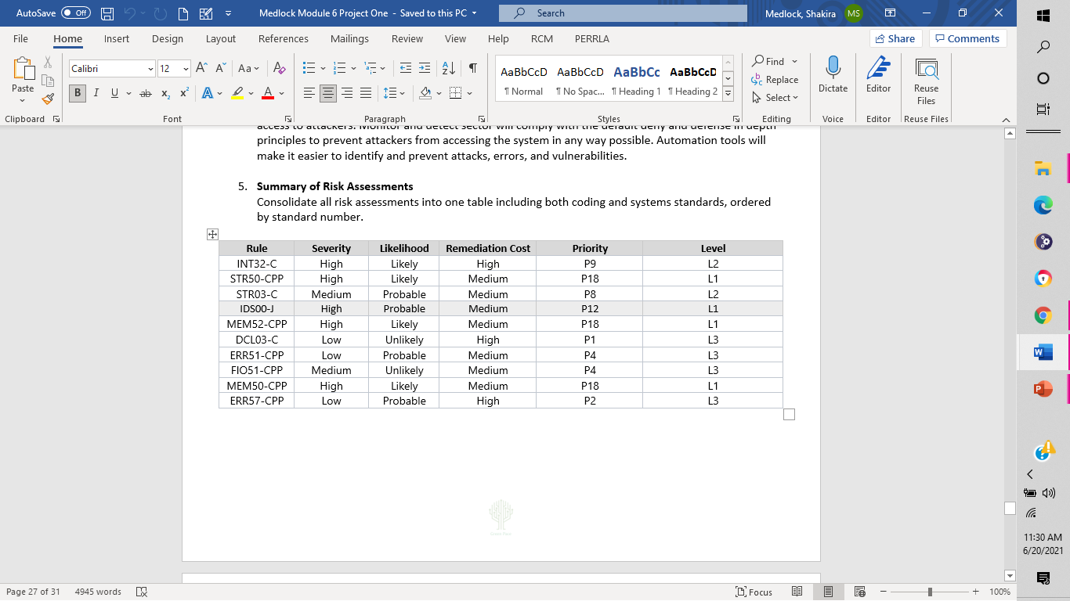
THREATS MATRIX
Notes:
Populate the Threats Matrix table and provide explanations to summarize all of your security risks. Demonstrate how you can use automation to detect these coding vulnerabilities.

Slide 4
10 PRINCIPLES
PRINCIPLES
Validate Input Data
Heed Compiler Warnings
Architect and Design for Security Policies
Keep It Simple
Default Deny
Adhere to the Principle of Least Privilege
Sanitize Data Sent to Other Systems
Practice Defense in Depth
Use Effective Quality Assurance Techniques
Adopt a Secure Coding Standard
CODING STANDARDS PRINCIPLES
Data Type 1,2, 9
Data Value 1
String Correctness 1, 9
SQL Injection 5, 6, 7
Memory Protection 9
Assertions 2, 9
Exceptions 2, 3
Input Output 3, 10
Memory Management 6
EXCEPTIONS 4, 8
Notes:
List the 10 principles, and list the coding standards that apply to each principle. This shows the alignment between principles and standards.

Slide 5
CODING STANDARDS
CODING STANDARDS
Data Type
Data Value
String Correctness
SQL Injection
Memory Protection
Assertions
Exceptions
Input Output
Memory Management
EXCEPTIONS
Notes:
List the 10 coding standards in priority order, and then explain your system of prioritization.
Ensure that operations on signed integers do not result in overflow
This is overflow that is undefined. Integer operations will overflow if the resulting value cannot be represented by the underlying representation of the integer.
Guarantee that storage for strings has sufficient space for character data and the null terminator
Buffer overflow occurs when there is not enough space to hold the data that is being copied to the buffer. To eliminate buffer overflow, make sure there is equivalent space to store the data and use truncation.

Slide 6
ENCRYPTION POLICIES
Encryption in rest | Encryption in rest protects the unencrypted data by encryption(other form of data) that cannot be read unless there is an encryption key to decode it. This data is usually on a disk, and it prevents hackers/unauthorized users from accessing it
Encryption at flight | Encryption at flight is data that is encrypted while it is being sent or received. This prevents the data from being read while in transmission.
Encryption in use | Encryption in use is used in all stages of encryption rather it is in rest or in flight or in use. Regardless, if the data is at rest, in flight or in use, it is protected at every stage whether it is from the source or the destination such as storage locations and memory.
Notes:
Summarize the policies for encryption in flight, at rest, and in use

Slide 7
TRIPLE-A POLICIES
Authentication | Authentication is the very first step in the Triple A Framework. This is used by applications or systems to verify/identify users and making sure the user is who the user says they are. Users have usernames and passwords to verify identity. Other forms of identification are single sign-on (SSO) systems, biometrics, digital certificates, and public key infrastructure. This prevents unauthorized users from accessing an account or specific data in the systems.
Authorization | Authorization is a set of rules or policies that define who can access specific information. It is also used to enforce restrictions to deny access to specific users. Other types of authorization include route assignments, IP address filtering, bandwidth traffic management, and encryption.
Accounting | Accounting basically is logs that are created to monitor the user’s activity in the program or sessions. It records the time, activities, login credentials, and sent/received data.
Notes:
Summarize the policies that support authentication, authorization, and accounting.

Slide 8
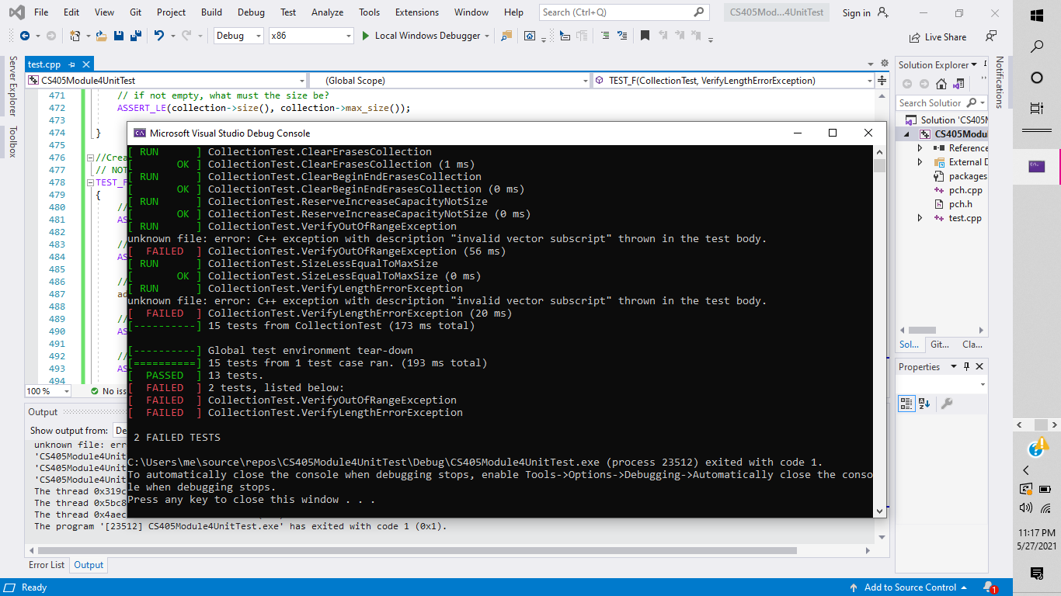
Unit Testing
Test that a collection is empty when created.
TEST_F(CollectionTest, IsEmptyOnCreate)
{
// is the collection empty?
ASSERT_TRUE(collection->empty());
// if empty, the size must be 0
ASSERT_EQ(collection->size(), 0);
}

Slide 9
Unit Testing
Create a test to verify adding a single value to an empty collection
TEST_F(CollectionTest, CanAddToEmptyVector)
{
// is the collection empty?
ASSERT_TRUE(collection->empty());
// if empty, the size must be 0
ASSERT_EQ(collection->size(), 0);
add_entries(1);
// is the collection still empty ?
ASSERT_FALSE(collection->empty());
// if not empty, what must the size be?
ASSERT_EQ(collection->size(), 1);
}

Slide 10
Unit Testing
Create a test to verify adding five values to collection
TEST_F(CollectionTest, CanAddFiveValuesToVector)
{
// is the collection empty?
ASSERT_TRUE(collection->empty());
// if empty, the size must be 0
ASSERT_EQ(collection->size(), 0);
add_entries(5);
// is the collection still empty ?
ASSERT_FALSE(collection->empty());
// if not empty, what must the size be?
ASSERT_EQ(collection->size(), 5);
}

Slide 11
Unit Testing
Create a test to verify resizing decreases the collection to zero
TEST_F(CollectionTest, VerifyResizingDecreasesToZero)
{
// is the collection empty?
ASSERT_TRUE(collection->empty());
// if empty, the size must be 0
ASSERT_EQ(collection->size(), 0);
// ADD 10 ENTRIES TO THE COLLECTION
add_entries(10);
// is the collection still empty?
ASSERT_FALSE(collection->empty());
// if not empty, what must the size be?
ASSERT_EQ(collection->size(), 10);
// DECREASE THE COLLECTION BY 10 to 0
collection->resize(0);
// is the collection empty?
ASSERT_TRUE(collection->empty());
// if empty, what must the size be?
ASSERT_EQ(collection->size(), 0);
}

Slide 12
Unit Testing
Create a test to verify reserve increases the capacity but not the size of the collection
TEST_F(CollectionTest, ReserveIncreaseCapacityNotSize) {
// is the collection empty?
ASSERT_TRUE(collection->empty());
// if empty, the size must be 0
ASSERT_EQ(collection->size(), 0);
//is the capacity empty?
ASSERT_EQ(collection->capacity(), 0);
//INCREASE CAPACITY TO FIVE, NOT SIZE
collection->reserve(5);
// is the collection still empty ?
ASSERT_TRUE(collection->empty());
// if empty, what must the size be?
ASSERT_EQ(collection->size(), 0);
//CHECK CAPACITY INCREASED BY 5
ASSERT_EQ(collection->capacity(), 5);
}

Slide 13

AUTOMATION SUMMARY
Notes:
Automation enforcement of the standards should begin in the Design sector and Verify and Test sector of the DevSecOps. This will ensure that all written code can be designed to be kept simple, easy to navigate, and easy to understand. Verify and Test of automation will ensure vulnerabilities and errors are caught early in the development cycle and will aid in preventing sql injections by denying access to attackers. Monitor and detect sector will comply with the default deny and defense in depth principles to prevent attackers from accessing the system in any way possible. Automation tools will make it easier to identify and prevent attacks, errors, and vulnerabilities.

Slide 14
TOOLS
DevSecOps PIPELINE
MULTI LEVEL SECURITY
WAYS TO IMPLEMENT SECURITY
BEGINNING TO END PROCESS
BUILD
DESIGN
VERIFY
TEST
RESPOND
TOOLS USED
GOOGLE TEST SUITE
CPP CHECK
AUTOMATED TESTING
Notes:
Automation enforcement of the standards should begin in the Design sector and Verify and Test sector of the DevSecOps. This will ensure that all written code can be designed to be kept simple, easy to navigate, and easy to understand. Verify and Test of automation will ensure vulnerabilities and errors are caught early in the development cycle and will aid in preventing sql injections by denying access to attackers. Monitor and detect sector will comply with the default deny and defense in depth principles to prevent attackers from accessing the system in any way possible. Automation tools will make it easier to identify and prevent attacks, errors, and vulnerabilities.

Slide 15
RISKS AND BENEFITS
ACTING NOW WAITING
LOWERS COST INCREASES COST
PROTECTS IMPORTANT DATA DATA IS COMPROMISED
PREVENTS ATTACKS PRONE TO MORE ATTACKS
IMPLEMENTING SECURITY EARLY FAILURE TO IMPLEMENT SECURITY
Notes:
State the problems, solutions, and the risks or benefits involved if you act now or decide to wait.

Slide 16
RECOMMENDATIONS
GAPS
MORE SECURITY
FUTURE THREATS
RESOLVING ISSUES BEFORE/AFTER
Notes:
Moving forward, explain your gap analysis of the existing security policy and future potential gaps and improvements. You will be graded on the quality of the supporting details you provide. Do you offer real-world examples to support your claims? If the explanation is logical, it will be considered proficient. If you provide evidence (e.g., a real-world example, link, or citation), you will exceed expectations.
What current gaps in the security policy still need to be addressed?

Slide 17
CONCLUSIONS
ALL STANDARDS SHOULD BE EMPLOYED TO PROTECT AND DEFEND THE SYSYTEM
HACKER’S MOTIVES
DEFENSE IN DEPTH
DON’T LEAVE SECURITY TO THE END
SECURE CODING
Notes:
What standards should be adopted to prevent future problems?

Slide 18
REFERENCES
Seacord, R. (2018). Top 10 Secure Coding Practices - CERT Secure Coding - Confluence. Wiki.sei.cmu.edu. Retrieved 20 June 2021, from https://wiki.sei.cmu.edu/confluence/display/seccode/Top+10+Secure+Coding+Practices.
[Vishwanath, A. (2021). Opinion: The failures that led to the Colonial Pipeline ransomware attack. CNN. Retrieved 13 May 2021, from https://www.cnn.com/2021/05/13/opinions/colonial-pipeline-ransomware-attack-was-stoppable-vishwanath/index.html.
What is Defense in Depth?. Forcepoint. (2021). Retrieved 14 May 2021, from https://www.forcepoint.com/cyber-edu/defense-depth.
What is Defense in Depth | Benefits of Layered Security | Imperva. Learning Center. Retrieved 14 May 2021, from https://www.imperva.com/learn/application-security/defense-in-depth/.

